Slide 1

Create Elegant Web Pages with Bootstrap
ZACHARY LLOYD - GC Digital Fellow
&
CHELSEA LANE - GC Postdoctoral Fellow

Slide 2

Presented by…
The Graduate Center Digital Initiatives brings together the work of scholars and technologists at the CUNY Graduate Center to pioneer new modes of inquiry that integrate digital tools and methods into the research, teaching, and service missions of the university. We do so by fostering communities of creative and critical practice among students, faculty, and staff through programs, events, workshops, grant-funded projects, consultations, and more.
https://gcdi.commons.gc.cuny.edu/

Slide 3
Getting Involved
Join the GCDI Group on the CUNY Academic Commons for updates on how to be involved. cuny.is/group-gcdi
Check the Event Calendar for upcoming events and workshops. cuny.is/workshops
Request a one-on-one consultation. cuny.is/gcdfconsults
Join the R Users Group (RUG) at cuny.is/rug
Join the GIS Working Group at cuny.is/group-gis-working-group
Join the Data Visualization Group at : cuny.is/dvg
Join the Python Users Group (PUG) at cuny.is/pug

Slide 4
Workshop Prerequisites
Before we begin, make sure you have the following available to you on your computer:
VS Code (make sure you have installed the Live Server extension)
The “Bootstrap Workshop” Folder from Github downloaded on your Desktop

Slide 5

Workshop Goals
1) Learn how to read and utilize documentation.
2) Understand the basics of how to integrate and apply Bootstrap components.
3) Use Bootstrap and a text editor (VSCode) to build a small locally-hosted website.
Notes:
We separated the workshop into two parts–an hour of general introduction to Bootstrap, what it is, how to use it, etc and an hour of more applied practice, building components, laying out an actual page, etc.

Slide 6
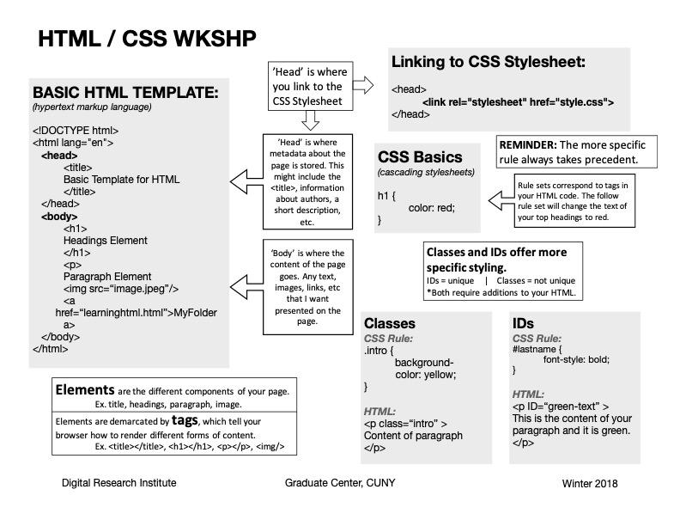
HTML & CSS Cheatsheet
Notes:
HTML, or HyperText Markup Language, is a markup language used to write web-based documents. It enables us to provide web browsers with information about the content of a document. We can, for example, indicate that some part of our document is a paragraph, image, heading, or link. The browser uses this information when displaying the document for users.
CSS, or Cascading Style Sheets, is often used in conjunction with HTML. While HTML tells the browser what the different parts of a document are, CSS tells the browser what the parts of the document should look like. It is essentially a set of rules that are applied when rendering an HTML document. Its name—Cascading Style Sheets—refers to the fact that there is an order of precedence in how the browser applies CSS rules to a document. More specific rules overwrite less specific rules.
Programming language – gives logic to a computer

Slide 7
Local Hosting
Together, these languages can be used to write and style a website using a text editor (such as VSCode) directly from your computer (or locally). No internet access is needed. (However, internet access is necessary if you plan on making your website available to the public.)
In our activities during this workshop we will focus on building locally-hosted websites using a simple LiveServer extension in VSCode. Again, these are websites that you can open on your web browser; however, they only exist on your own device and are only accessible to you. Locally-hosted websites are not yet on the public-facing Internet.

Slide 8

Part 1: Bootstrap Basics

Slide 9
What is Bootstrap?
The official Bootstrap website describes it as:
“The most popular HTML, CSS, and JS framework for developing responsive, mobile-first projects on the web.”
In plainer terms, Bootstrap is a collection or library of predefined, reusable bits of CSS code that enables you to quickly build responsive websites. Bootstrap saves you from writing lots of your own CSS code and instead allows you to focus on the overall structure and design of your site.

Slide 10
Useful Features
Predefined/built-in themes
Responsive grid system
Responsive image manipulation and rendering
Relatively easy customization
Excellent documentation
Large community and user-created templates

Slide 11
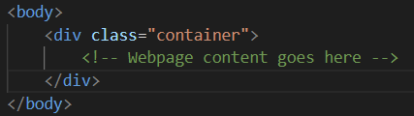
How It Works
Bootstrap uses containers and classes as its fundamental building blocks. Containers allow you to contain, pad, and align your content on the page within a given device in a responsive way. Classes allow us to define these elements’ style.
Here’s an example of the basic structure:
Notes:
Containers are the most basic layout element in Bootstrap and are required when using our default grid system.
In the background, you are importing a .container class that Bootstrap has defined, just as you would if you were to write a container class yourself.

Slide 12
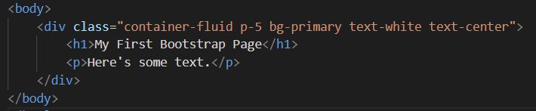
How It Works cont’d
With these containers, you can specify any number of properties for the content within. For example:
Here we are specifying that all content in the <div> container is fluid (more on that later), has padding, has a background color, a text color, and centered text.
Notes:
Containers are the most basic layout element in Bootstrap and are required when using our default grid system.

Slide 13

The Result?
Note that this is achieved without writing any CSS ourselves!
Notes:
Containers are the most basic layout element in Bootstrap and are required when using the default grid system.

Slide 14

Demonstration!

Slide 15
Getting Started
Navigate to the official Bootstrap website:
https://getbootstrap.com/
Access the installation docs to see how to integrate Bootstrap into your project

Slide 16
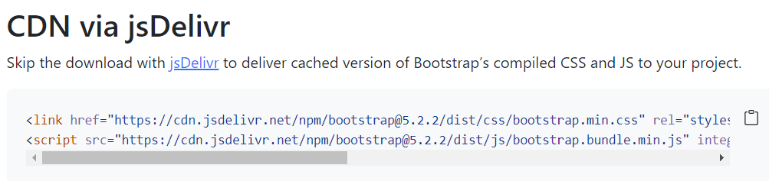
Integrating Bootstrap
We’ll use the jsDelivr CDN (Content Delivery Network):
The first line <link> goes in the <head> tags
The second line <script> goes in the <body> tags

Slide 17
Recreating Our Example

Slide 18
The Bootstrap Grid System
One of the fundamental features of Bootstrap is its grid system. The grid system uses a series of containers, columns, and rows to layout and align content on a webpage.
The grid system is responsive, and the columns will rearrange depending on the screen size of a given device. This allows you to quickly and easily structure your content without worrying about manually determining widths and margins.
Notes:
One of the fundamental features of Bootstrap, CSS has its own built-in grid system nowadays but didn’t when Bootstrap was created (part of its purpose)

Slide 19
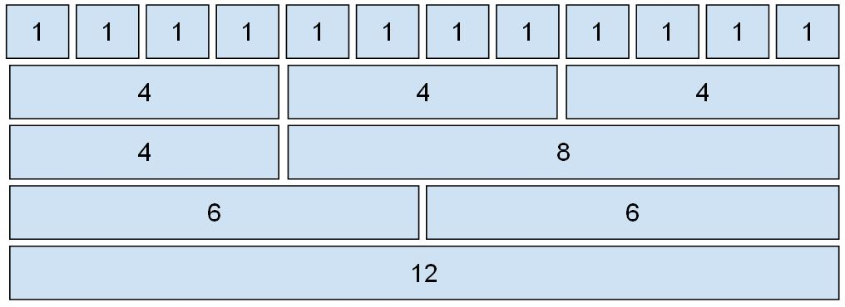
The Grid
The grid allows 12 possible columns, with any number of rows. You can use all combinations of values summing up to 12. You can use 12 columns each of width 1, or use 4 columns each of width 3, or any other combination.

Slide 20
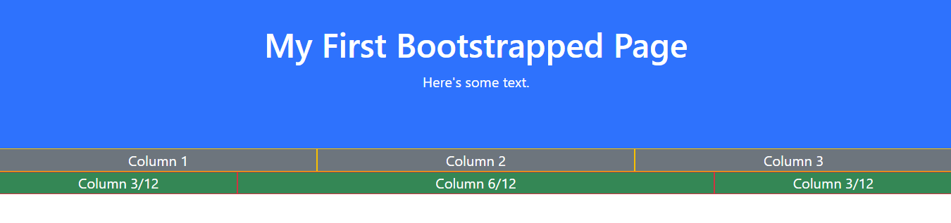
Example
Here’s an example of adding columns to our page. The top row is evenly sized for each column, while the bottom row has two outer columns sized to 3, with a size 6 column in between.

Slide 21
Demonstration!
Notes:
Mention .container-fluid, which is width: 100% at all breakpoints

Slide 22
Sizing Breakpoints
There are six “breakpoint” sizes for devices that you can target. At each breakpoint, Bootstrap will responsively set content to fit depending on the screen size.
xs (<576px): For Portrait Mobile Phones.
sm (>=576px): For Landscapes phones
md (>=768px): For Tablets
lg (>=992px): For Small-sized Desktops/Laptops
xl (>=1200px): For Larger-sized Desktops/Laptops

Slide 23
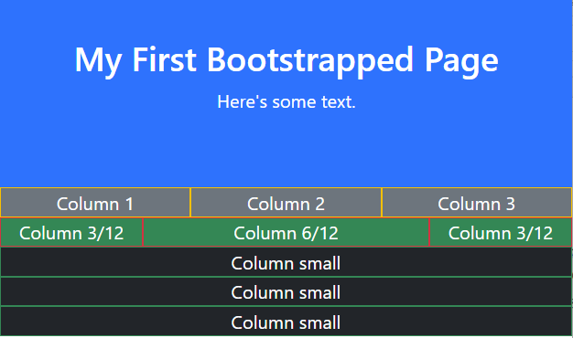
Example
Let’s say we wanted to add columns targeted for small devices like smartphones. Instead of displaying all the columns on one row, we’d want the columns to stack when resized, for easier readability, like so:

Slide 24
Demonstration!

Slide 25
Bootstrap Documentation
One of the great things about Bootstrap is its extensive documentation.
https://getbootstrap.com/docs/4.1/getting-started/introduction/
Along the sidebar you can view the details for almost every feature and component of Bootstrap.
Notes:
One of the fundamental features of Bootstrap, CSS has its own built-in grid system nowadays but didn’t when Bootstrap was created (part of its purpose)

Slide 26

Practice Time!

Slide 27
Challenges
Integrate Bootstrap into the practice1.html file provided.
In the <body>, create a new <div> with a Bootstrap container class.
Add some content to the class, like a header and a paragraph, and give it some styling (text color, bkg color, etc.)
Add some columns and rows (however many you’d like) below the header.
Add some content to the columns (like paragraphs or images).
Try resizing your browser window as you work to see how the content responds!
Notes:
One of the fundamental features of Bootstrap, CSS has its own built-in grid system nowadays but didn’t when Bootstrap was created (part of its purpose)

Slide 28
Part 2: Bootstrap Components

Slide 29
Add a Navbar
Using the Navbar documentation on Bootstrap’s website, make the following changes to your base index.html file:
Add a generic Navbar by copying the first large chunk of code and inserting into your file.
Create an “About Me” section in the Navbar. Then, create an id for the <h2> associated with the “About Me” section (e.g. id= “aboutme” and hyperlink to it from the navbar (hint: use #).
Delete the “Search” section encompassed in <form> and the “Disabled” section encompassed in <li>
Add your personal img to the Navbar and rename “Navbar” to your name (or preferred site name).
Bonus points: add in a Bootstrap icon instead.
Change the Navbar color to dark .
Replace the text “Dropdown” with “Things I Like.”
Move the contents of your “Things I Like” list to the dropdown menu and add relevant hyperlinks. Then, delete the “Things I Like” <h2>, <a>, and <li> sections from the main body of your webpage.
Make the Navbar sticky.
Bonus: add custom CSS in your style.css file using the “nav” element to make your Navbar’s opacity equal 80%.
Notes:
Color: (hint: replace “navbar-light bg-light” with “navbar-dark bg-dark”)

Slide 30

Add a Carousel
Using the Carousel documentation on Bootstrap’s website, make the following changes to your base index.html file:
Copy and paste in the generic carousel code from Bootstrap.
Add your img, alt text, and id to the first carousel slide.
Add a descriptive caption to the first slide.
Add another img to the carousel.
Delete the third carousel div or add a third image.
Bonus: crop images to have the same dimensions for uniformity (I like to use Canva for this).

Slide 31
Play time!
Choose another component we haven’t looked at yet, and customize your site (N.B.: you may need to add additional html content in order to experiment fully with some of the options).

Slide 32
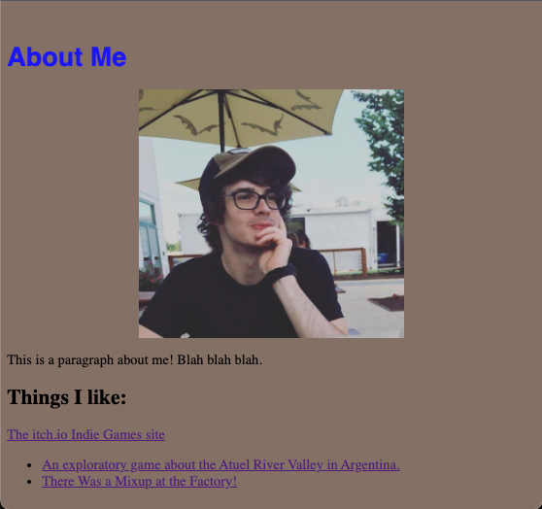
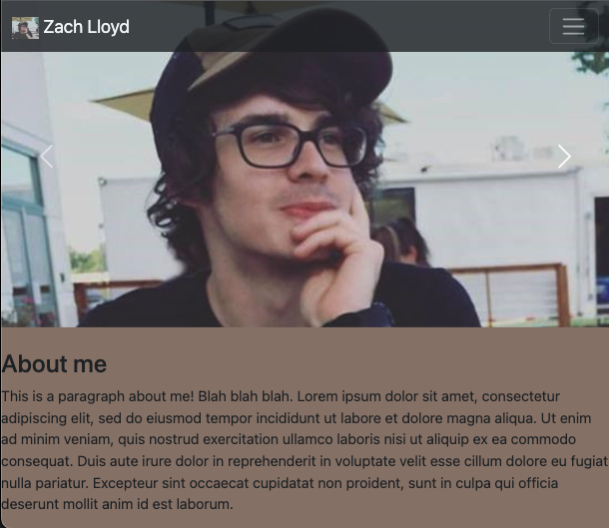
The Result
Notes:
With your practice using Bootstrap, you might now…
Feel more comfortable reading and implementing documentation
Give a pre-existing website a facelift

Slide 33
Join our next workshop!
This workshop has been the second in a series of workshops devoted to web development.
Stay tuned for additional web development workshop offerings this spring by regularly checking our calendar and following us on social media:
Follow GCDI on Twitter: @cunygcdi
Follow the GC Digital Fellows on Twitter: @Digital_Fellows
Follow the #digitalGC hashtag on Twitter
Follow the GC Digital Fellows blog, Tagging the Tower: digitalfellows.commons.gc.cuny.edu
Follow the GC Digital Fellows on Instagram: @digital_fellows
Notes:
https://courses.cs.washington.edu/courses/cse154/15sp/cheat-sheets/css-cheat-sheet.pdf
https://gcdi.commons.gc.cuny.edu/event/using-bootstrap-to-create-visually-stunning-webpages/

Slide 34

Thank you for coming!
PLEASE, take a moment to fill out a short evaluation:
http://cuny.is/gcdifeedback

